Slide 1


Know ahead, don’t end up dead!

Slide 2


Slide 3
Concept
Travel app that allows the user to plan their trip
With all the travel apps available today, being able to search a city, explore the area and help plan their itinerary in one place is a must have.
As a user, I want to search for a city, find out where it is and know what would be fun to check out if I decide to visit.

Slide 4
Process
To achieve our end goal we utilized a few different API’s including Open Weather, Google Maps API, & Google places API.
Sydney mastered the html and display aspects utilizing Materialize CSS (https://materializecss.com/). James worked on the logic to achieve the functionality and researched what each API required to make function. Maxwell setup the Github repository, created a new project that allowed us to assign the assorted tasks, made the Readme, and created a custom graphic to bring our app alive.
One challenge we had was Google requires a different call then a normal AJAX call.
Our biggest success was finally being able to display the map in our app.

Slide 5


Slide 6
Directions for Future Development
Need to add HTML links for the returned attraction items so the user can easily get to that attraction's homepage.
Need to add markers for the returned attraction list items.
Need to figure out how to secure the API keys to ensure there is no unwanted access.
Need to research what is required for a mobile app, both for the Google Play store and the Apple app store.
Need to allow the user to pick what city they want if it exists in multiple locations.

Slide 7
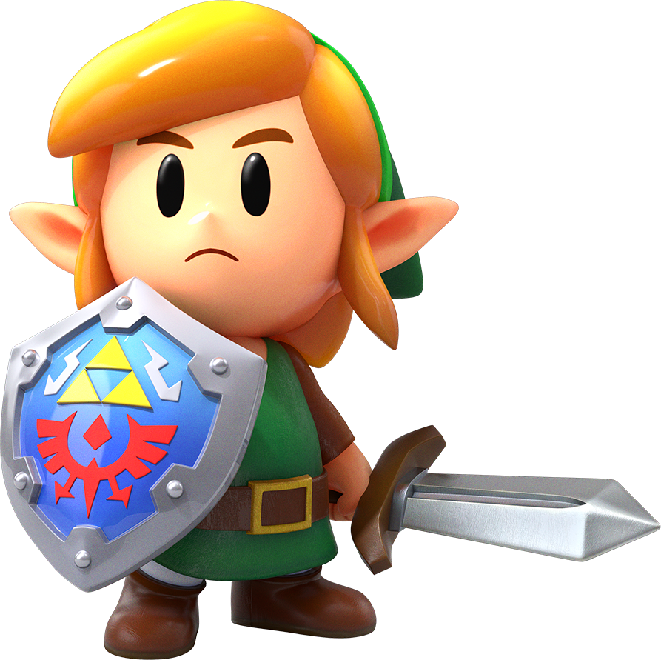
Links
Deployed
https://maxskewes.github.io/Homework07/index.html
GitHub repo
https://github.com/maxskewes/Homework07.git

